Slide 1
The Accounting Cycle Capturing Economic Events
Chapter: 03

Slide 2
The Ledger
An accounting system includes a separate record for each item that appears in the financial statements.
For example, a separate record is kept for the asset cash, showing all increases and decreases in cash resulting from the many transactions in which cash is received or paid.

Slide 3
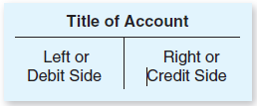
The Use of Accounts
Its called a T- account because of its resemblance to the letter “ T.”
Its simplest form, an account has only three elements: (1) a title; (2) a left side, which is called the debit side; and (3) a right side, which is called the credit side.

Slide 4
Debits & Credits
Debits are the left of the T account.
Debits do not mean increase.
Debits are not “good” or “bad”.
Credits are the right of the T account.
Credits do not mean decrease.
Credits are not “good” or “bad”.

Slide 5
Debit and Credit Entries
In simple terms, debits refer to the left side of an account, and credits refer to the right side of an account. To illustrate the recording of debits and credits in an account, let us go back to the eight cash transactions of Overnight Auto Service, described in Chapter 2.

Slide 6
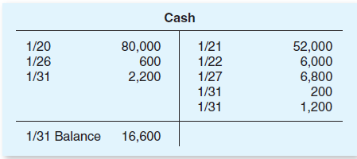
When these cash transactions are recorded in the Cash account, the receipts are listed on the debit side, and the payments are listed on the credit side. The dates of the transactions may also be listed, as shown in the following illustration:

Slide 7
Determining the Balance of a T Account
The balance of an account is the difference between the debit and credit entries in the account.
If the debit total exceeds the credit total, the account has a debit balance;
if the credit total exceeds the debit total, the account has a credit balance.

Slide 8
In our illustrated Cash account, a line has been drawn across the account following the last cash transaction recorded in January. The total cash receipts (debits) recorded in January amount to $82,800, and the total cash payments (credits) amount to $66,200. By subtracting the credit total from the debit total ($82,800 -$66,200), we determine that the Cash account has a debit balance of $16,600 on January 31.

Slide 9
Debit Balances in Asset Accounts
In the preceding illustration of a Cash account,
increases were recorded on the left, or debit, side of the account and decreases were recorded on the right, or credit, side. The increases were greater than the decreases and the result was a debit balance in the account.
All asset accounts normally have debit balances

Slide 10
Debits & Credits
Assets, Exp Liabilities, Equity
& Dividends & Revenues
DR CR DR CR
Incr. Decr. Decr. Incr.
+ - - +
If you remember this one, the “other one” is the reverse.

Slide 11
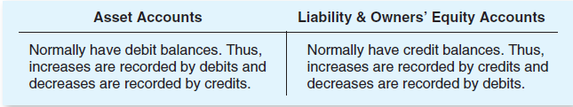
Concise Statement of the Debit and Credit Rules

Slide 12

DOUBLE-ENTRY ACCOUNTING—THE EQUALITY OF DEBITS AND CREDITS
The rules for debits and credits are designed so that every transaction is recorded by equal dollar amounts of debits and credits.

Slide 13
If this equation is to remain in balance, any change in the left side of the equation (assets) must be accompanied by an equal change in the right side (either liabilities or owners’ equity).
According to the debit and credit rules that we have just described, increases in the left side of the equation (assets) are recorded by debits, while increases in the right side (liabilities and owners’ equity) are recorded by credits, as illustrated below:

Slide 14
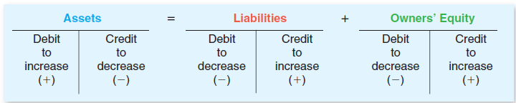
This system is often called double-entry accounting. The phrase double-entry refers to the need for both debit entries and credit entries, equal in dollar amount, to record every Transaction.
Later in this chapter, we will see that the double-entry system allows us to measure net income at the same time we record the effects of transactions on the balance sheet accounts.

Slide 15
The Journal

Slide 16
The journal
The journal is a chronological (day-by-day) record of business transactions. At convenient intervals, the debit and credit amounts recorded in the journal are transferred (posted) to the accounts in the ledger. The updated ledger accounts, in turn, serve as the basis for preparing the company’s financial statements.

Slide 17
To illustrate the most basic type of journal, called a general journal, let us examine the very first business transaction of Overnight Auto Service. Recall that on January 20, 2011, the McBryan family invested $80,000 in exchange for capital stock. Thus, the asset Cash increased by $80,000, and the owners’ equity account Capital Stock increased by the same amount.

Slide 18
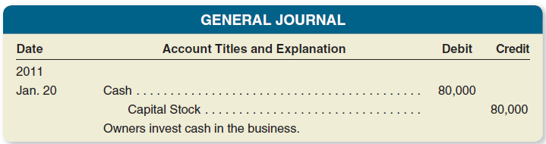
Recording a Transaction in the GENERAL JOURNAL

Slide 19
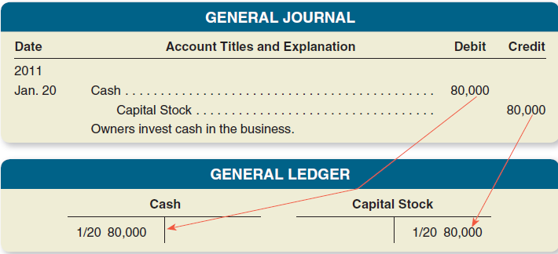
POSTING JOURNAL ENTRIES TO THE LEDGER ACCOUNTS (AND HOW TO “READ” A JOURNAL ENTRY)

Slide 20
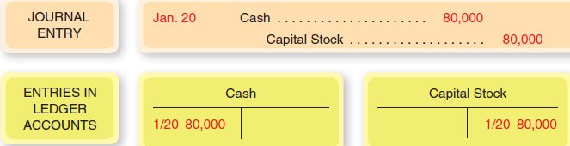
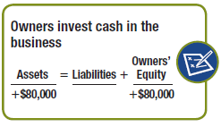
Recording Balance Sheet Transactions: An Illustration
1. Jan. 20 Michael McBryan and family invested $80,000 cash in exchange for capital stock.

Slide 21
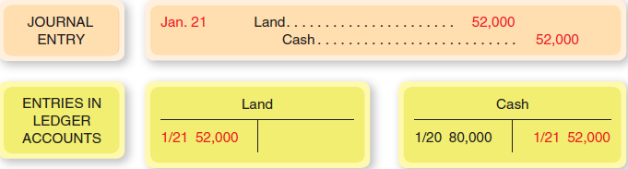
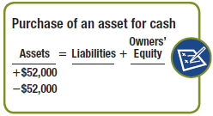
Jan. 21 On January 21, overnight Auto Service purchased the land from the city for $52,000 cash.

Slide 22
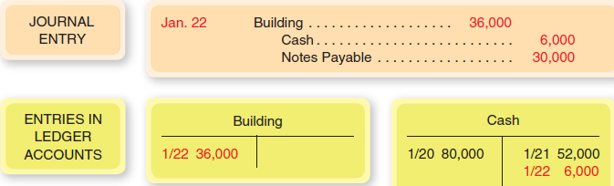
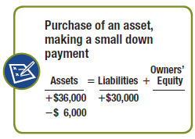
Jan. 22 Overnight completed the acquisition of its business location by purchasing the abandoned building from the MTA. The purchase price was $36,000; Overnight made a $6,000 cash down payment and issued a 90-day, non-interest-bearing note payable for the remaining $30,000.

Slide 23
Example
On April 01, 2016 Anees started business with
Rs. 100,000 and other transactions for the month are:
2. Purchase Furniture for Cash Rs. 7,000.
8. Purchase Goods for Cash Rs. 2,000 and for Credit Rs. 1,000 from Khalid Retail Store.
14. Sold Goods to Khan Brothers Rs. 12,000 and Cash Sales Rs. 5,000.
18. Owner withdrew of worth Rs. 2,000 for personal use.
22. Paid Khalid Retail Store Rs. 500.
26. Received Rs. 10,000 from Khan Brothers.
30. Paid Salaries Expense Rs. 2,000

Slide 24
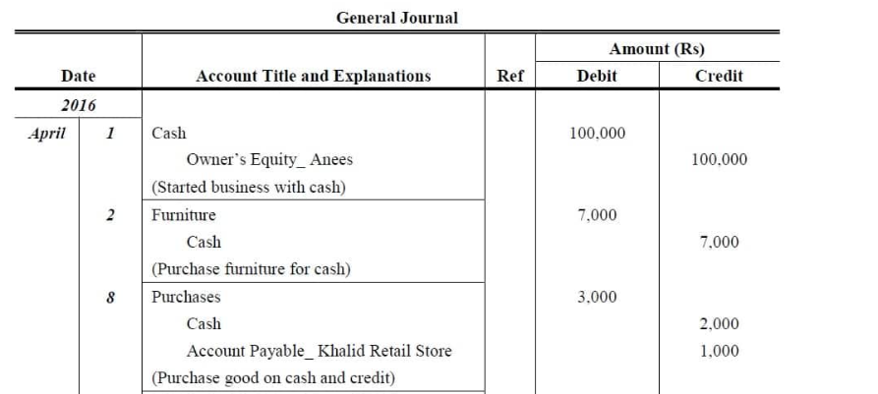
Solution

Slide 25

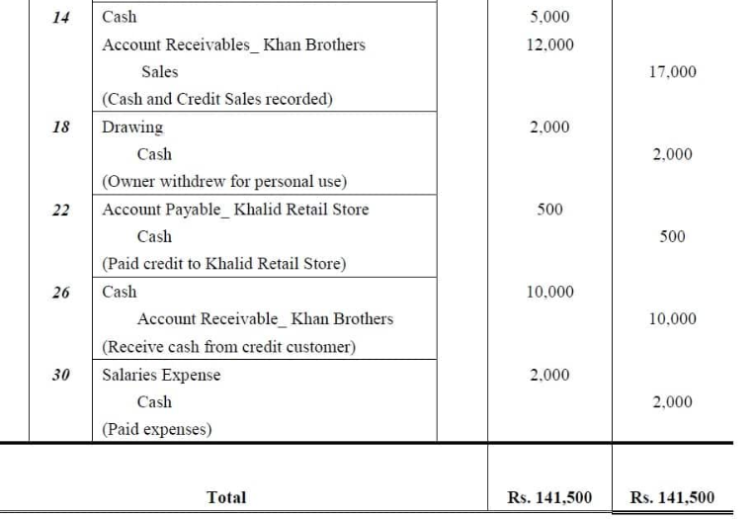

Slide 26
Dual Skill
To do a journal entry, you need to know
What accounts are moving/impacted
How to classify those accounts
Asset?
Liability?
Equity/Revenue/Expense/Dividend?
Where the accounts are going up or down
NOW you are ready to declare debit or credit!

Slide 27
Impact on accounts

Slide 28
Impact on accounts
Debit AR
Credit Sales Rev.
Debit Insurance Exp
Credit Prepaid
Debit Cash
Credit Land
Debit Cash
Credit AR
How do you show new credit sales [accounts receivable go up]?
How do you reflect prepaid insurance getting used up [go down]?
How do you take land you sold off the books [no gain or loss]?
How do you show an increase to cash from a customer paying their bill?

Slide 29
Liability Accounts

Slide 30
Liability Accounts
Debit Inventory
Credit Accts Payable
Debit Tax Payable
Credit Cash
Debit Old Loan
Credit New Loan
Debit Salaries Expense
Credit Salaries Payable
How do you show buying inventory on credit [accounts payable goes up]?
How do you reflect taxes payable getting paid [go down]?
How do you show paying off an old loan with a new loan?
How do you show the obligation to pay workers after their work is complete but not yet paid?

Slide 31
What do you need – debit or credit?
Make patents go up?
Make AP go down?
Make Revenue go up?
Make Expenses go up?
Make Mortgage Loan go up?
Make Salaries payable go down?
Make Cash go down?

Slide 32
What do you need – debit or credit?
Make patents go up?
Make AP go down?
Make Revenue go up?
Make Expenses go up?
Make Mortgage Loan go up?
Make Salaries payable go down?
Make Cash go down?
Debit
Debit
Credit
Debit
Credit
Debit
Credit

Slide 33
Cont:

Slide 34
Dividends
A dividend is a distribution of assets (usually cash) by a corporation to its stockholders. In some respects, dividends are similar to expenses—they reduce both the assets and the owners’ equity in the business. However, dividends are not an expense, and they are not deducted from revenue in the income statement. The reason why dividends are not viewed as an expense is that these payments do not serve to generate revenue. Rather, they are a distribution of profits to the owners of the business.

Slide 35
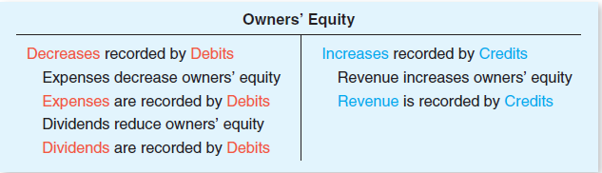
Since the declaration of a dividend reduces stockholders’ equity, the dividend could be recorded by debiting the Retained Earnings account. The debit–credit rules for revenue, expenses, and dividends are summarized below:

Slide 36
Classification of Accounts

Slide 37
Personal Accounts
(i) Natural Personal Accounts: Accounts of individuals relating to natural persons such as Akhil’s A/c, Rajesh’s A/c, Sohan’s A/c are natural personal accounts.
(ii) Artificial Personal Accounts: Accounts of companies, institutions such as Reliance Industries Ltd; Lions Club, M/s Sham & Sons, National College account are artificial personal accounts. These exist only in the eyes of law.

Slide 38
(iii) Representative Personal Accounts: The accounts which represent some person such as wage outstanding account, prepaid insurance account, accrued interest account are considered as representative personal accounts.

Slide 39
2. Real Accounts
Real accounts are the accounts related to assets/properties. These may be classified into tangible real account and intangible real account.
The accounts relating to tangible assets such as building, plant, machinery, cash, furniture etc. are classified as tangible real accounts.
Intangible real accounts are the accounts related to intangible assets such as goodwill, trademarks, copyrights, franchisees, Patents etc.

Slide 40
3. Nominal Accounts
The accounts relating to income, expenses, losses and gains are classified as nominal accounts. For example Wages Account, Rent Account, Interest Account, Salary Account, Bad Debts Accounts

Slide 41
RULES FOR DEBIT AND CREDIT
Type of Accounts |  | Rules for Debit | Rules for Credit
a | Personal Account | Debit the receiver | Credit the giver
b | Real Account | Debit what comes in | Credit what goes out
c | Nominal Account | Debit all expenses and losses | Credit all incomes and gains

Slide 42
Illustration: How will you classify the following into personal, real and nominal accounts?
(i) Investments
(ii) Freehold Premises
(iii) Accrued Interest
(iv) Punjab Agro Industries Corporation
(v) Janata Allied Mechanical Works
(vi) Salary Accounts
(vii) Loose Tools Accounts
(viii) Purchases Account

Slide 43
Illustration: How will you classify the following into personal, real and nominal accounts?
(i) Investments
(ii) Freehold Premises
(iii) Accrued Interest
(iv) Punjab Agro Industries Corporation
(v) Janata Allied Mechanical Works
(vi) Salary Accounts
(vii) Loose Tools Accounts
(viii) Purchases Account
(ix) Indian Bank Ltd.
(x) Capital Account
(xi) Brokerage Account
(xii) Toll Tax Account
(xiii) Dividend Received Account
(xiv) Royalty Account
(xv) Sales Account

Slide 44
Solution
Real Account: (i), (ii), (vii), (viii), (xv).
Nominal Account: (vi), (ix), (xi), (xii), (xiii), (xiv)
Personal Account: (iii), (iv), (v), (x)

Slide 45
Practice: Prepare Journal in the books of K.K. Co.from the following transactions:

